Slide 1
Computer Graphics 8:
Perspective Projections

Slide 2
Contents
In today’s lecture we are going to have a look at how perspective projections work in computer graphics

Slide 3
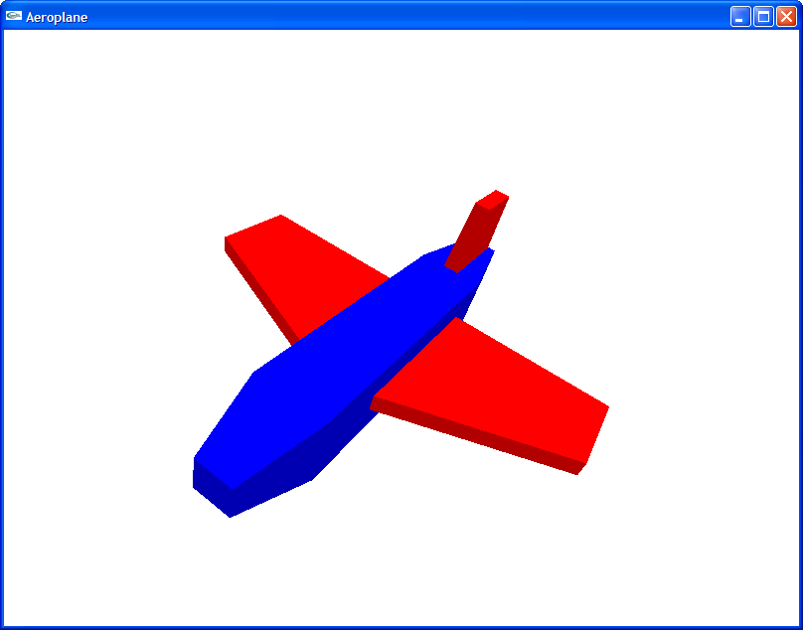
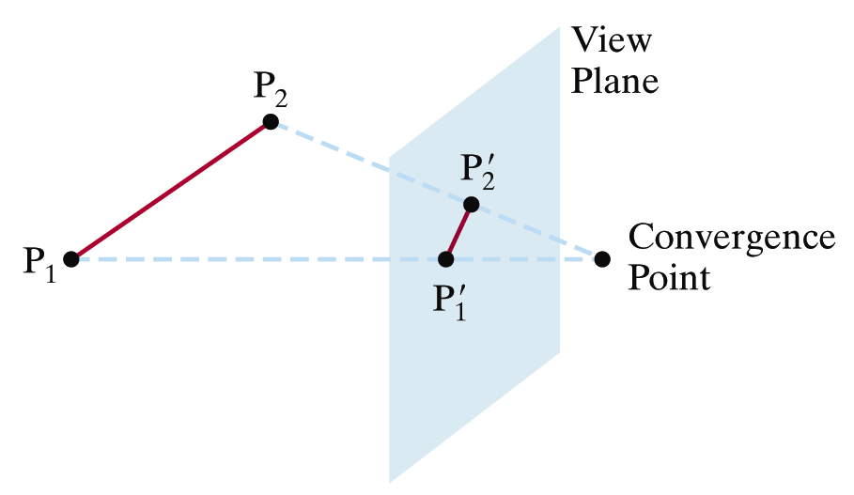

Perspective Projections
Remember the whole point of perspective projections
Images taken from Hearn & Baker, “Computer Graphics with OpenGL” (2004)

Slide 4
Projection Calculations
y axis
P=(x, y, z)
(x_{p}, y_{p}, z_{p})
(x_{prp}, y_{prp}, z_{prp})
z axis
x axis
View Plane

Slide 5
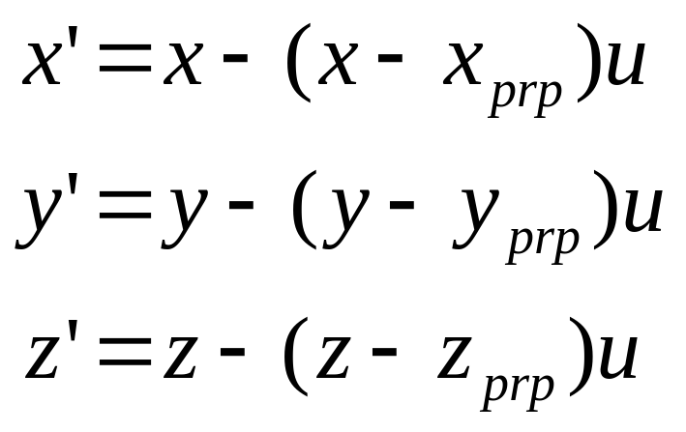
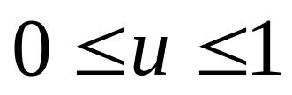
Projection Calculations (cont…)
Any point along the projector (x’, y’, z’) can be given as:
When u = 0 we are at P, while when u = 1 we are at the Projection Reference Point

Slide 6
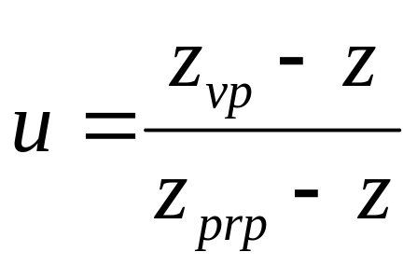
Projection Calculations (cont…)
At the view plane z’ = z_{vp} so we can solve the z’ equation for u:

Slide 7
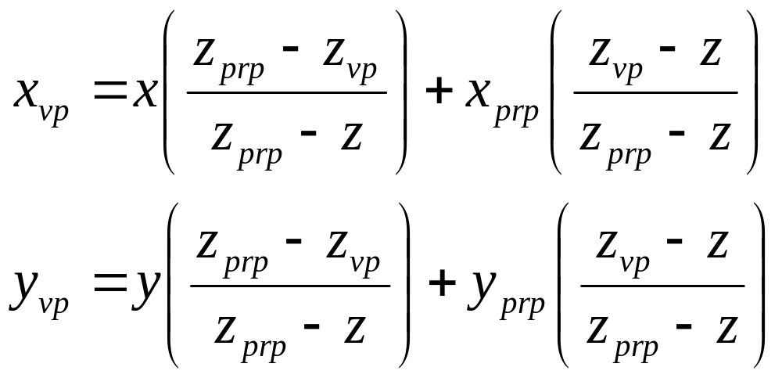
Projection Calculations (cont…)
Armed with this we can restate the equations for x’ and y’ for general perspective:

Slide 8
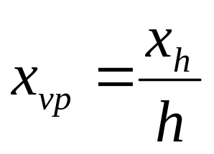
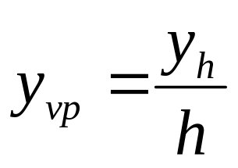
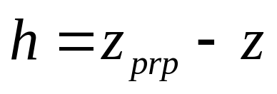
Perspective Projection Transformation Matrix
Because the x and y coordinates of a projected point are expressed in terms of z we need to do a little work to generate a perspective transformation matrix
First we use a homogeneous representation to give x_{vp} and y_{vp} as:
where:

Slide 9
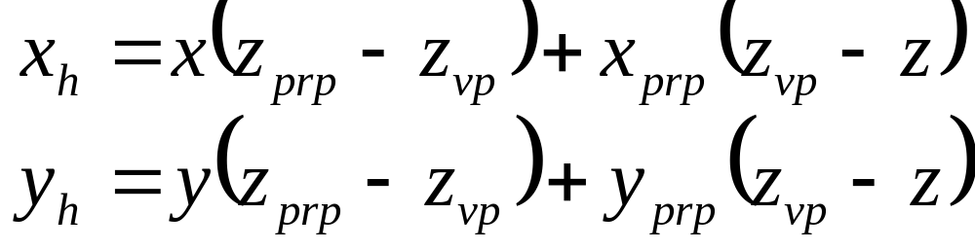
Perspective Projection Transformation Matrix (cont…)
From the previous equations for x_{vp} and y_{vp} we can see that:

Slide 10
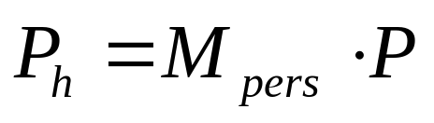
Perspective Projection Transformation Matrix (cont…)
Now we can set up a transformation matrix, that only contains perspective parameters, to convert a spatial position to homogeneous coordinates
First we calculate the homogeneous coordinates using the perspective-transformation matrix:
where P_{h} is the homogeneous point (x_{h}, y_{h}, z_{h}, h) and P is the coordinate position (x, y, z, 1)

Slide 11
Perspective Projection Transformation Matrix (cont…)
Setting up the matrix so that we calculate x_{h} and y_{h} is straightforward
However, we also need to preserve the z values – depth information
Otherwise the z coordinates are distorted by the homogeneous parameter h
We don’t need to worry about the details here, but it means extra parameters (s_{z} and t_{z}) are added to the matrix

Slide 12
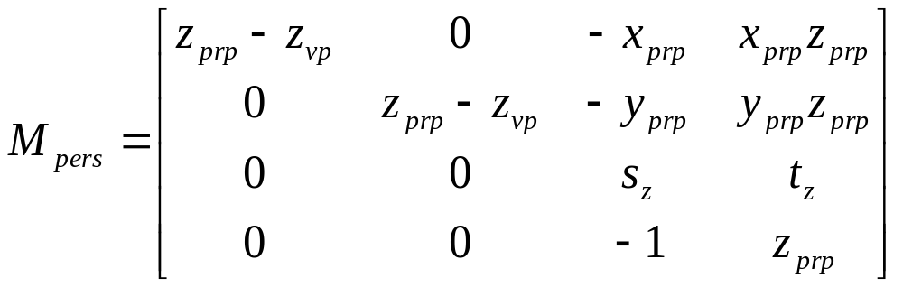
Perspective Projection Transformation Matrix (cont…)
The following is the perspective projection matrix which arises:

Slide 13
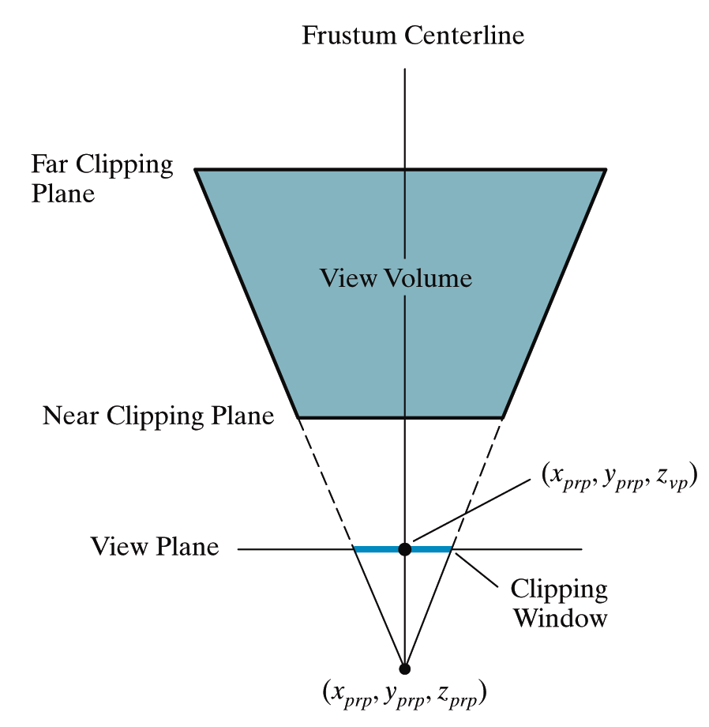
Setting Up A Perspective Projection
A perspective projection can be set up by specifying the position and size of the view plane and the position of the projection reference point
However, this can be kind of awkward
Images taken from Hearn & Baker, “Computer Graphics with OpenGL” (2004)

Slide 14
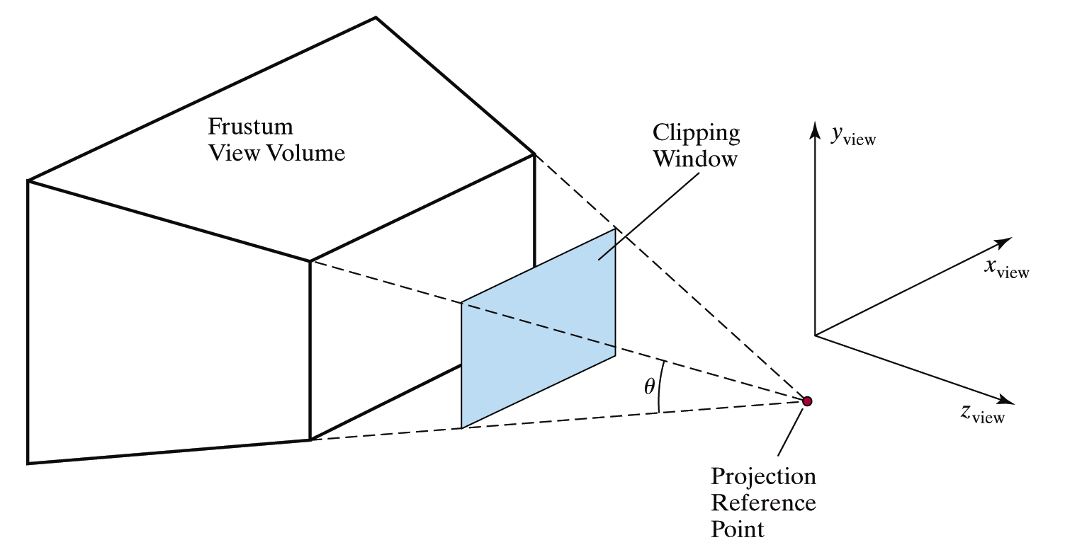
Setting Up A Perspective Projection (cont…)
The field of view angle can be a more intuitive way to specify perspective projections
This is analogous to choosing a lense for a camera
Images taken from Hearn & Baker, “Computer Graphics with OpenGL” (2004)
Field of view

Slide 15
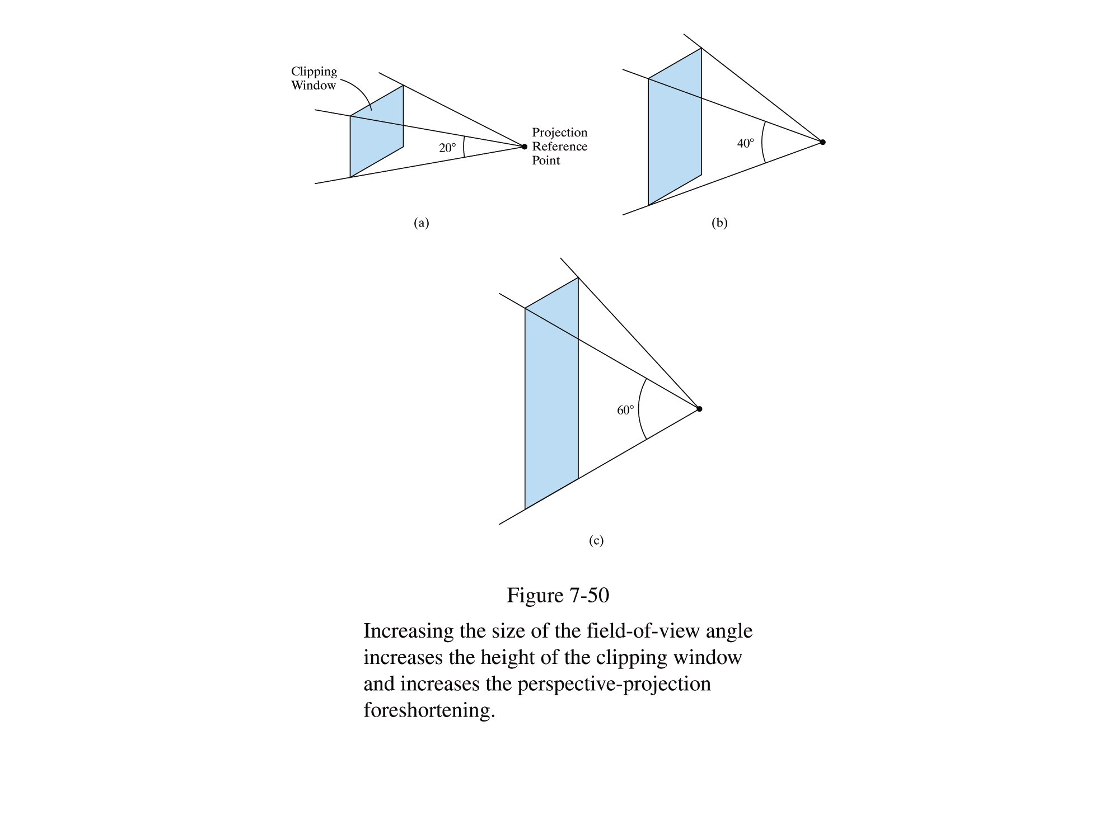
Setting Up A Perspective Projection (cont…)
Increasing the field of view angle increases the height of the view plane and so increases foreshortening
Images taken from Hearn & Baker, “Computer Graphics with OpenGL” (2004)

Slide 16
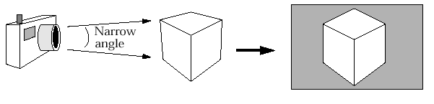
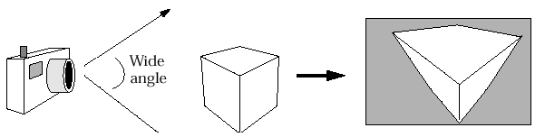
Setting Up A Perspective Projection (cont…)
The amount of foreshortening that is present can greatly affect the appearance of our scenes

Slide 17
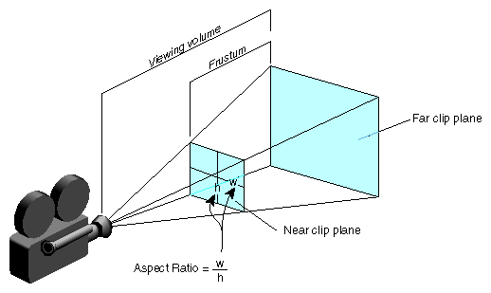
Setting Up A Perspective Projection (cont…)
We need one more thing to specify a perspective projections using the filed of view angle
The aspect ratio gives the ratio between the width sand height of the view plane

Slide 18
Summary
In today’s class we looked at the detail of generating a perspective projection of a three dimensional scene

